Slide 1
Fast skeleton-based deformation to reduce
3D printing support
Julia Gilenko, Peiqi Wang, Eris Zhang

Slide 2
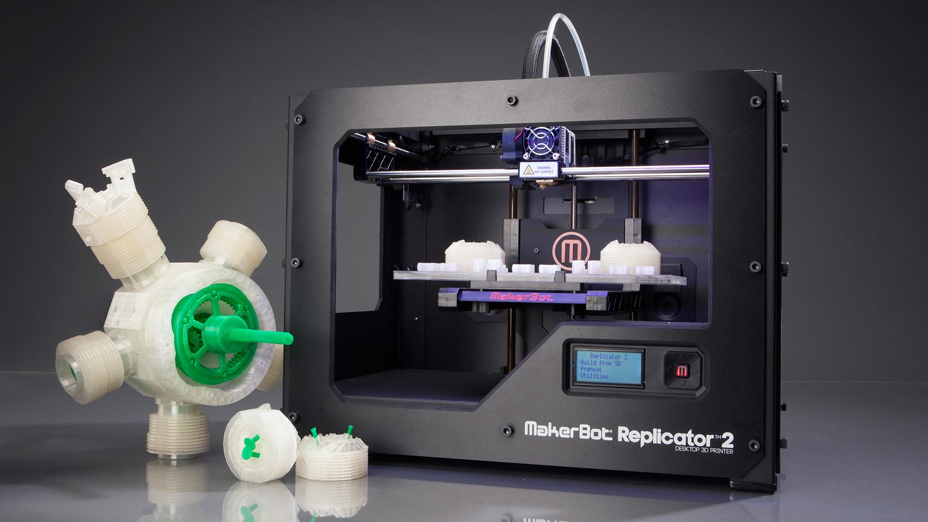

Slide 3
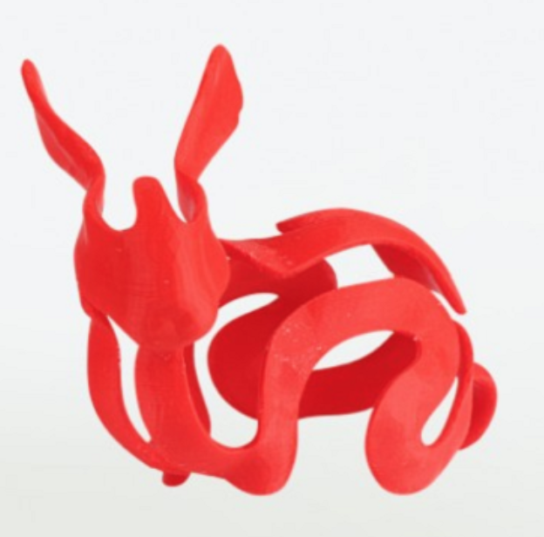
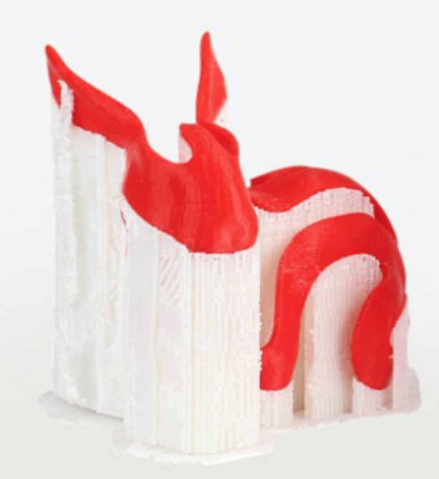

Slide 4
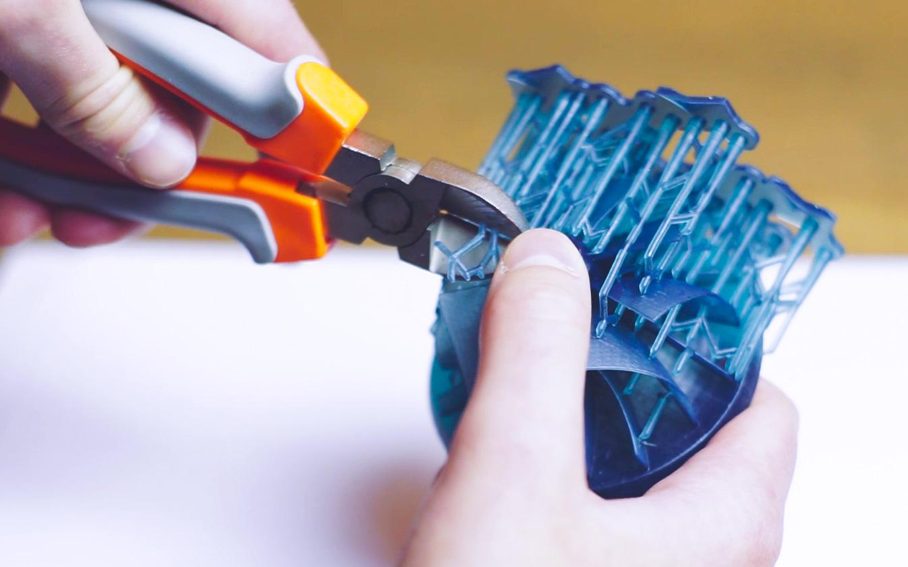

Slide 5
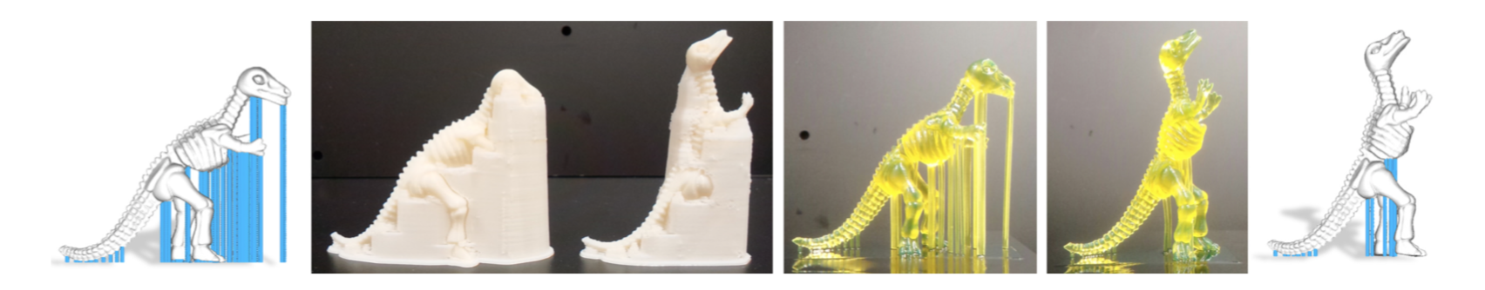
Related Work
Support Slimming for Single Material Based Additive Manufacturing K.Hu et al.
Clever Support: Efficient Support Structure Generation for Digital Fabrication J.Vanek et al.

Slide 6
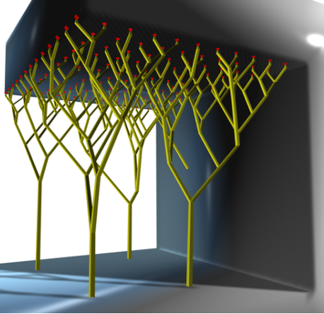
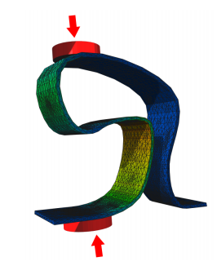
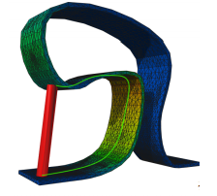
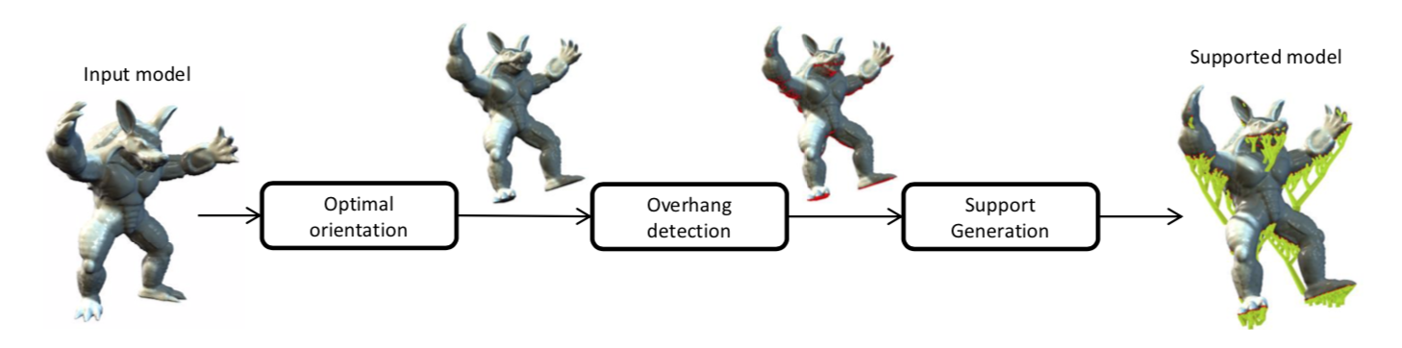
Related Work

Slide 7
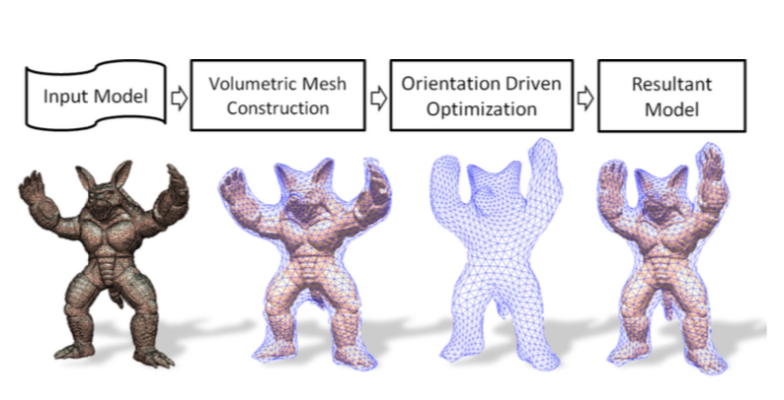
Related Work

Slide 8
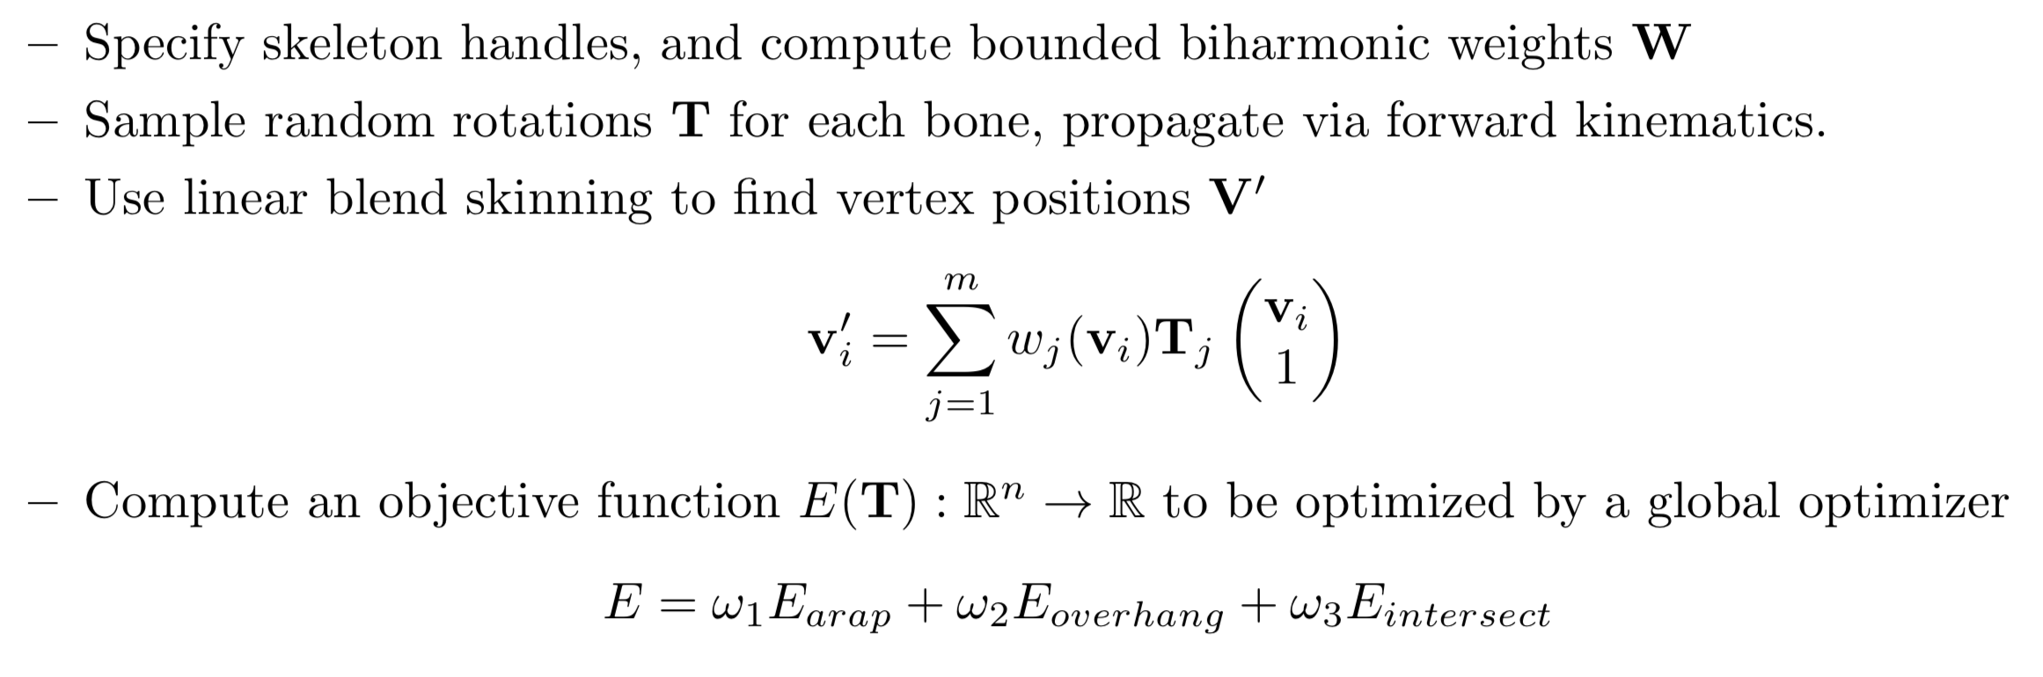
Our Method

Slide 9
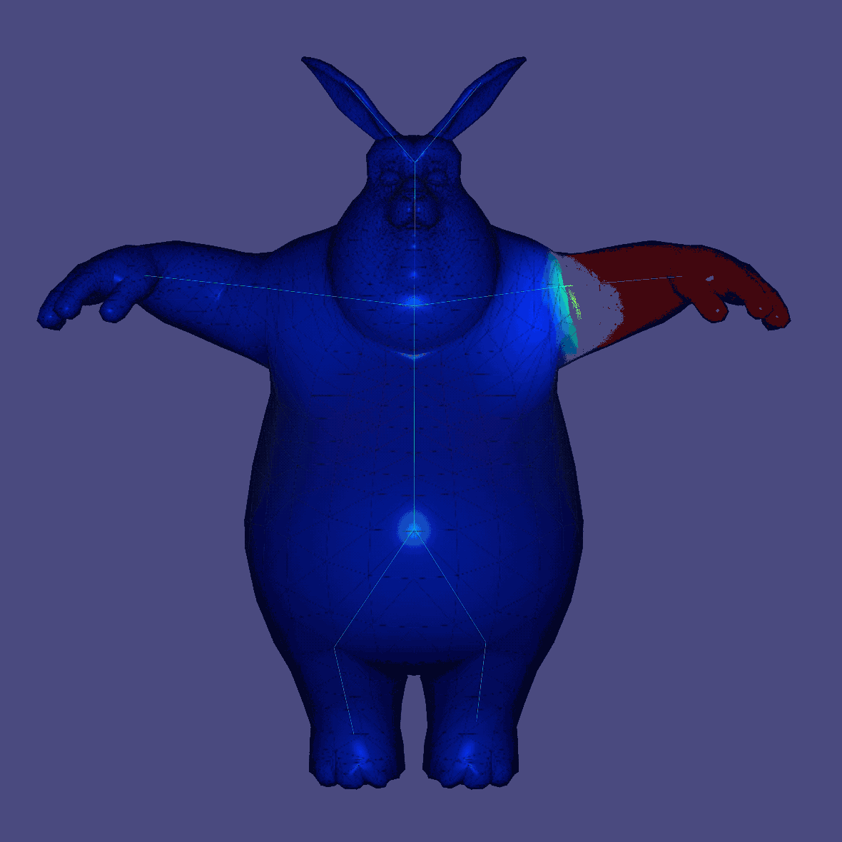
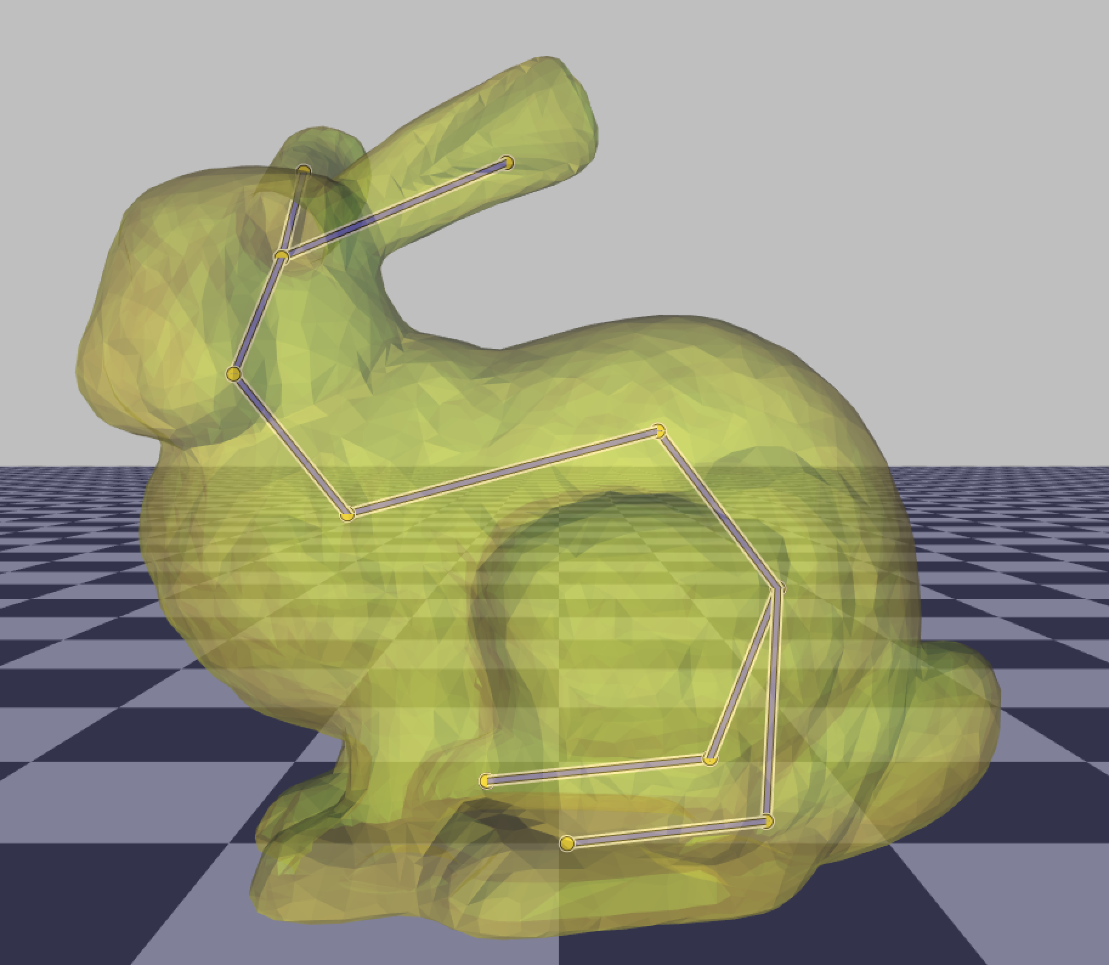
Specify skeleton handles
Bounded biharmonic weights

Slide 10
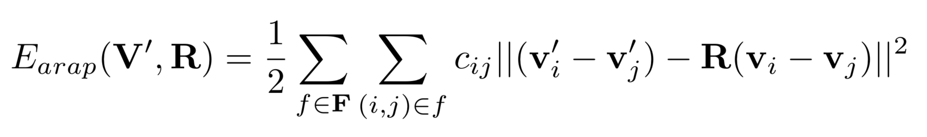
ARAP energy

Slide 11

Overhang energy

Slide 12
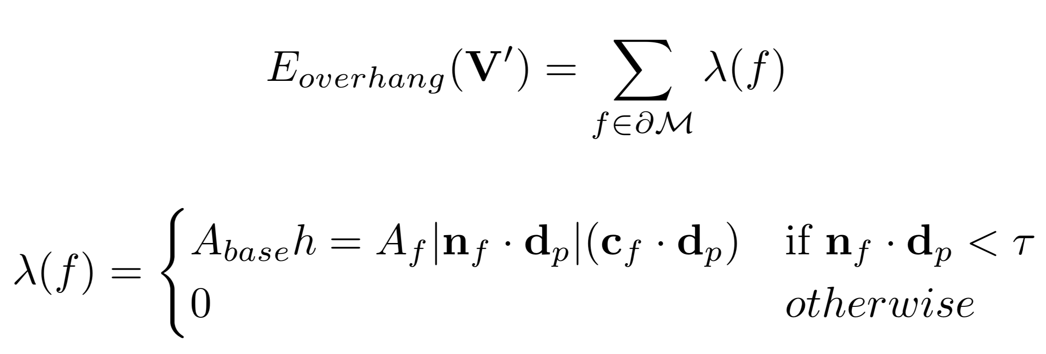
Overhang energy as volume underneath risky faces
Volume under a single face approximated by a rectangular prism

Slide 13
Self-intersection energy
Define a grid below the model and draw a ray up from every grid point
Energy = sum of volumes of all self-intersecting regions
Finer grid = more accurate approximation of volumes, but slower
More efficient: examine each face and determine which grid point(s) are beneath it

Slide 14
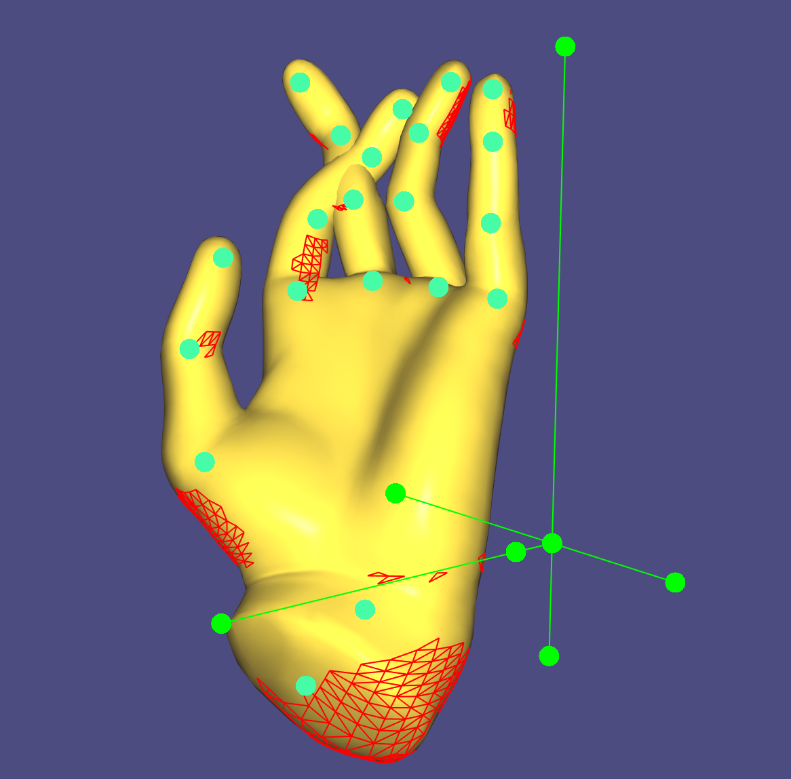
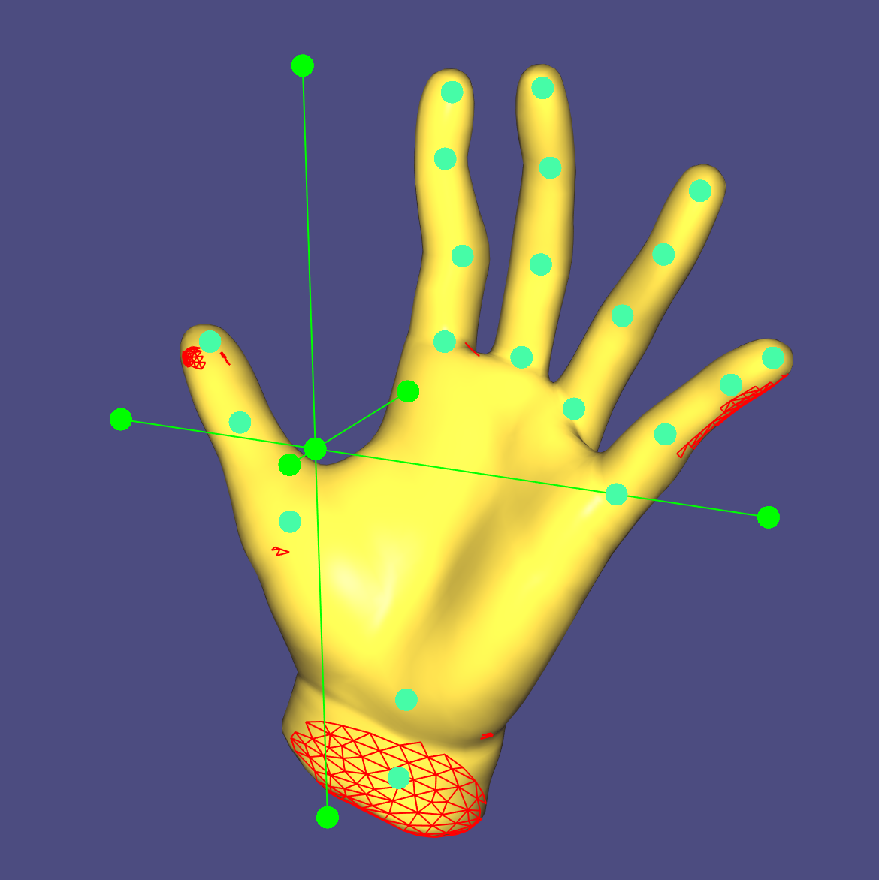

Slide 15
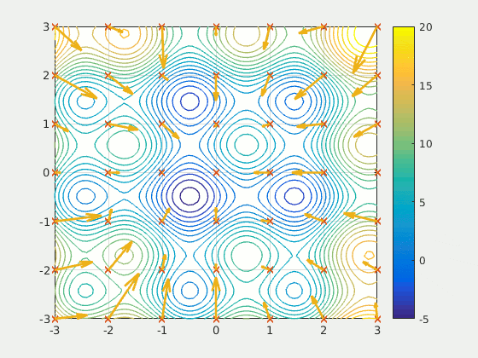
Particle Swarm Optimization
Black box optimizer without the need for gradient
Particle movement guided by local best and global best solutions

Slide 16
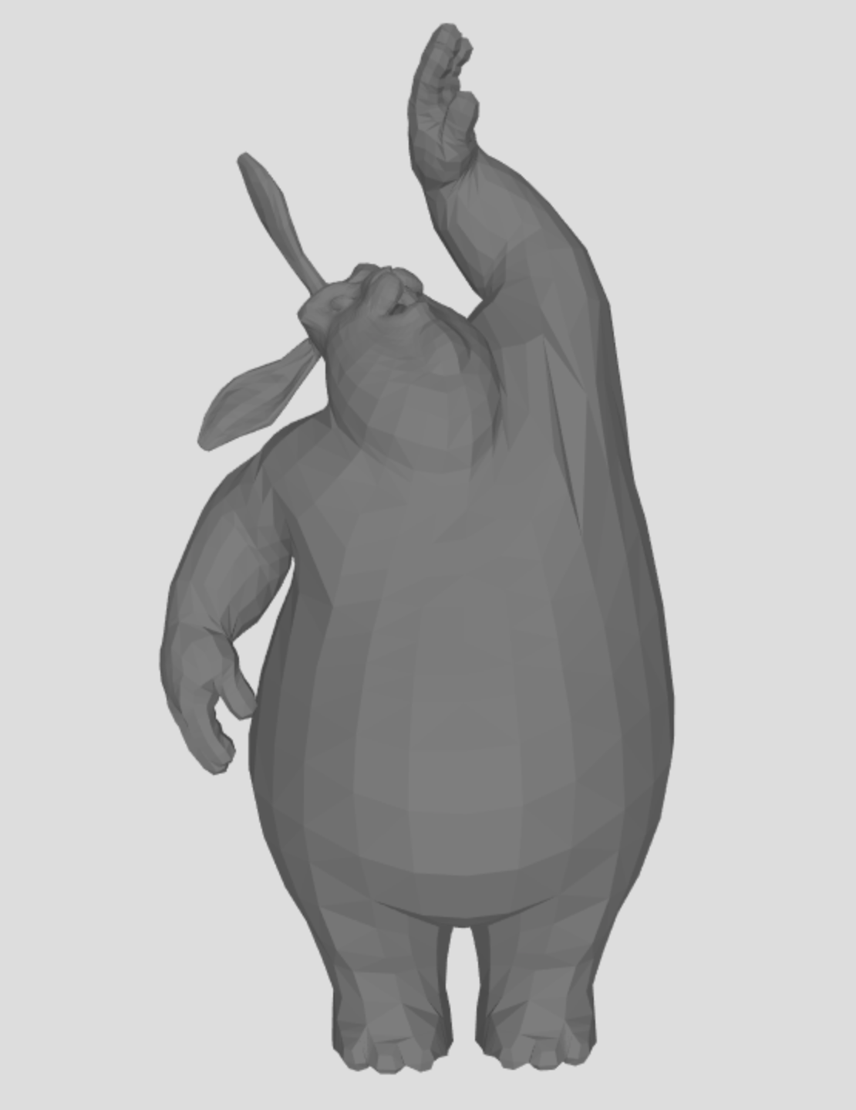
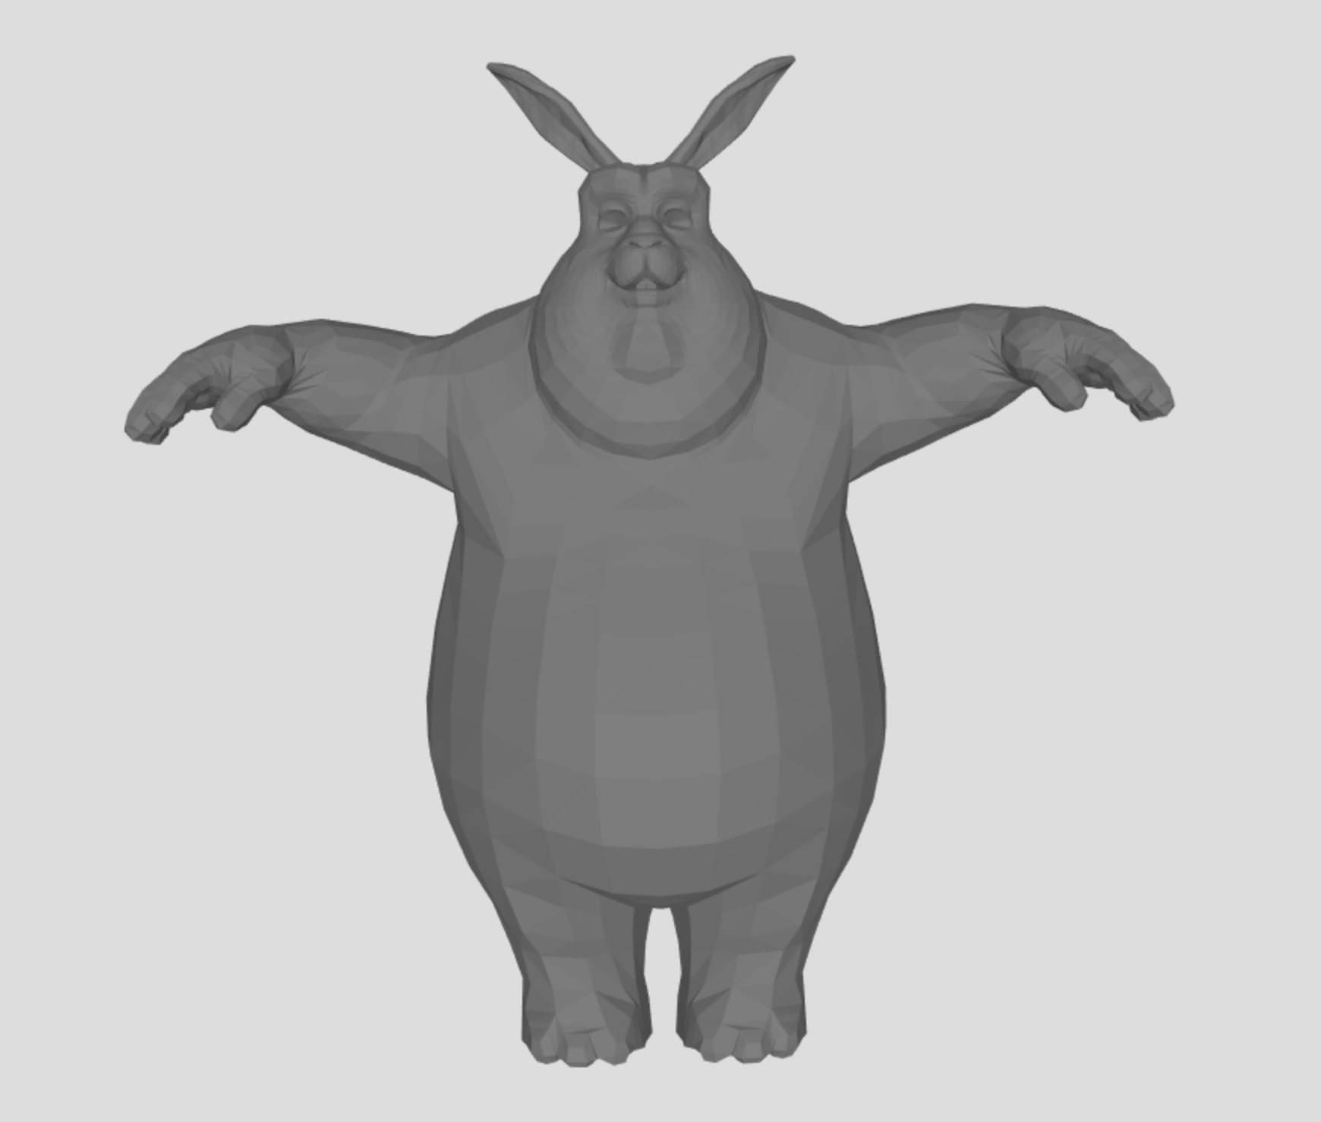

Results

Slide 17
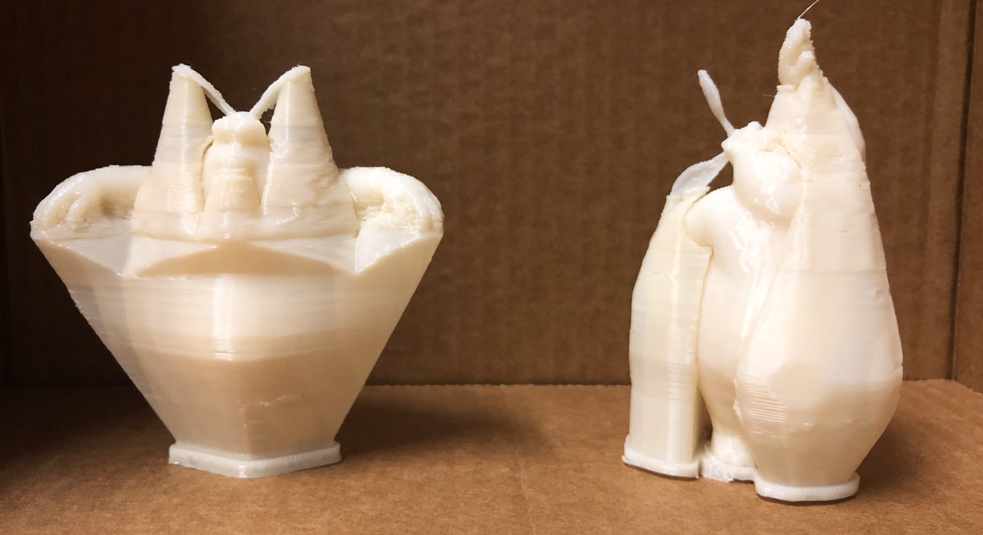
Support reduced by 15%

Slide 18
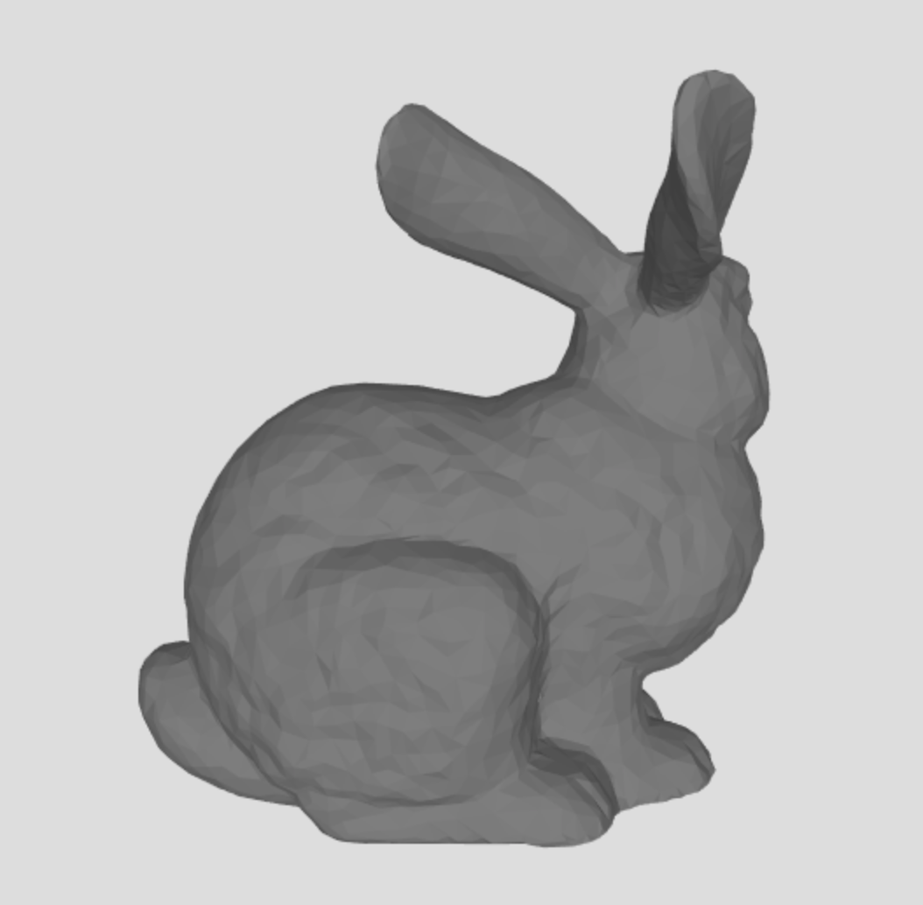
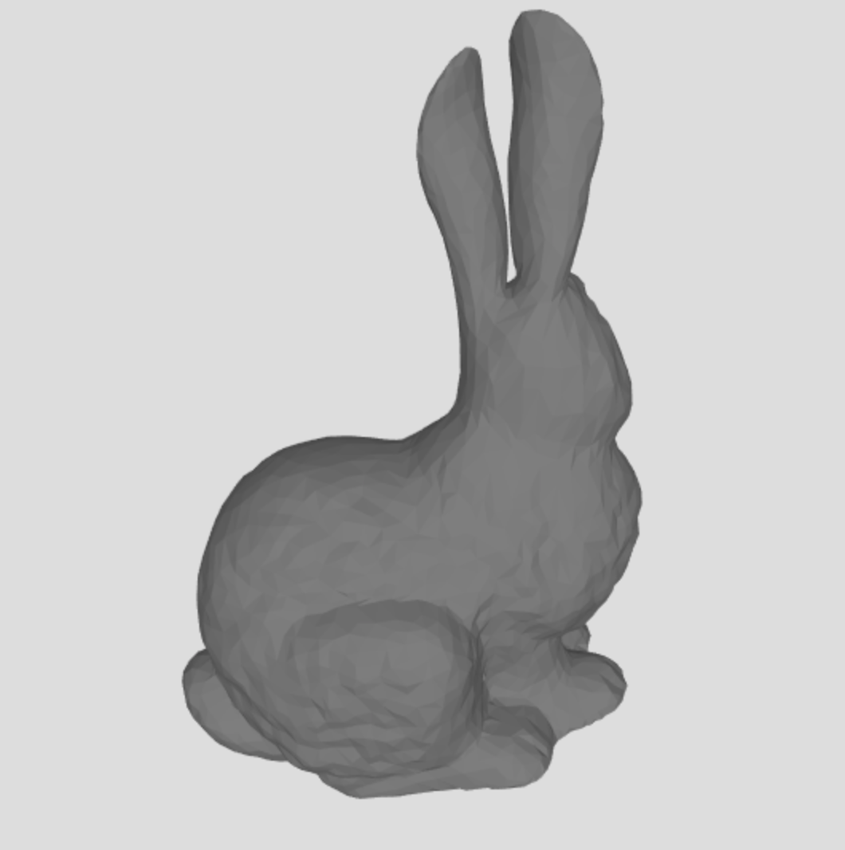

Slide 19
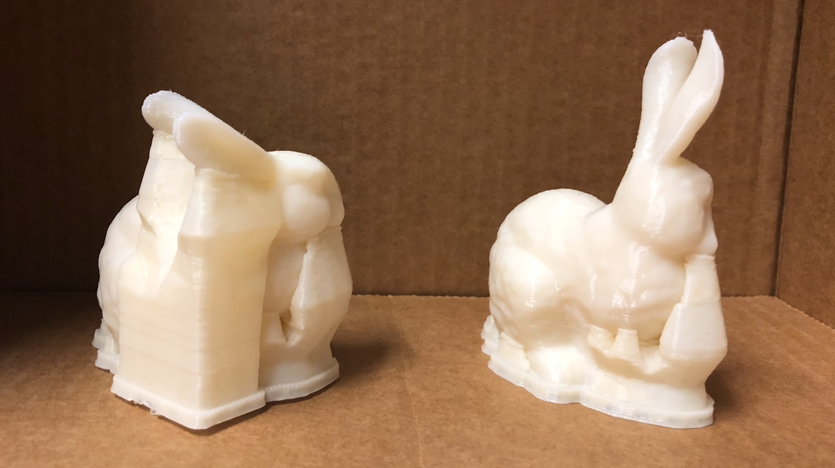
Support reduced by 37%

Slide 20
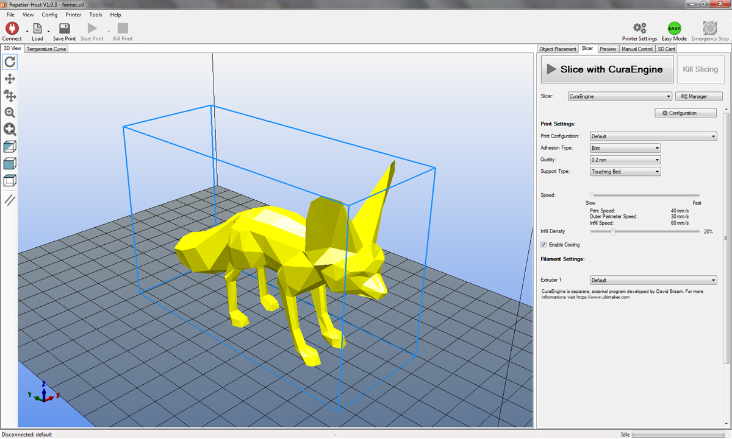
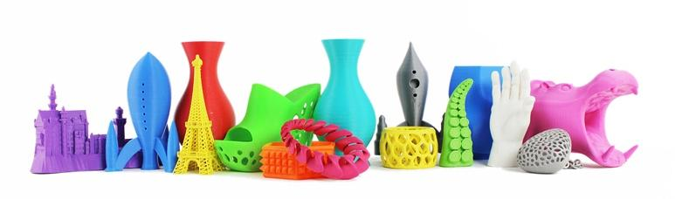
Future work
Make it interactive
Optimize the pipeline with OpenGL for real-time computation
Account for center of mass for balancing
Make It Stand: Balancing Shapes for 3D Fabrication (SIGGRAPH 2013)
Account for support generation algorithm
Currently, the overhang energy does not reflect the reality
Multi-objective optimization often conflicting (distortion vs. overhang)
Need more investigation on better methods

Slide 21
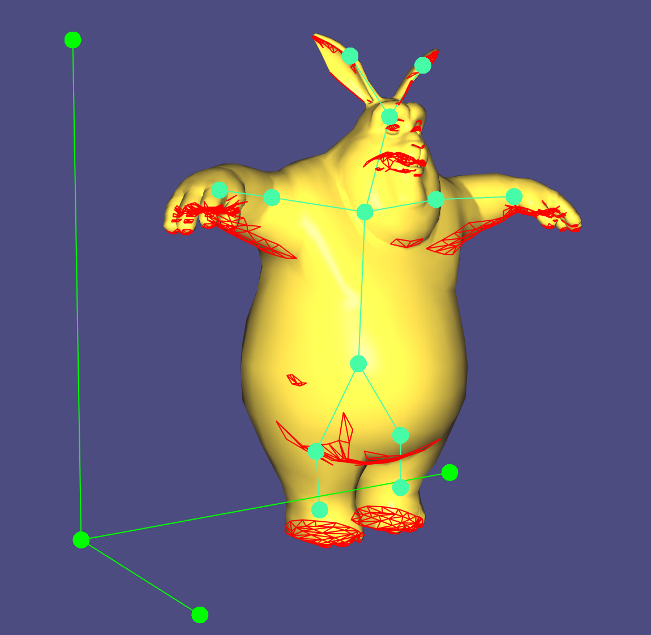
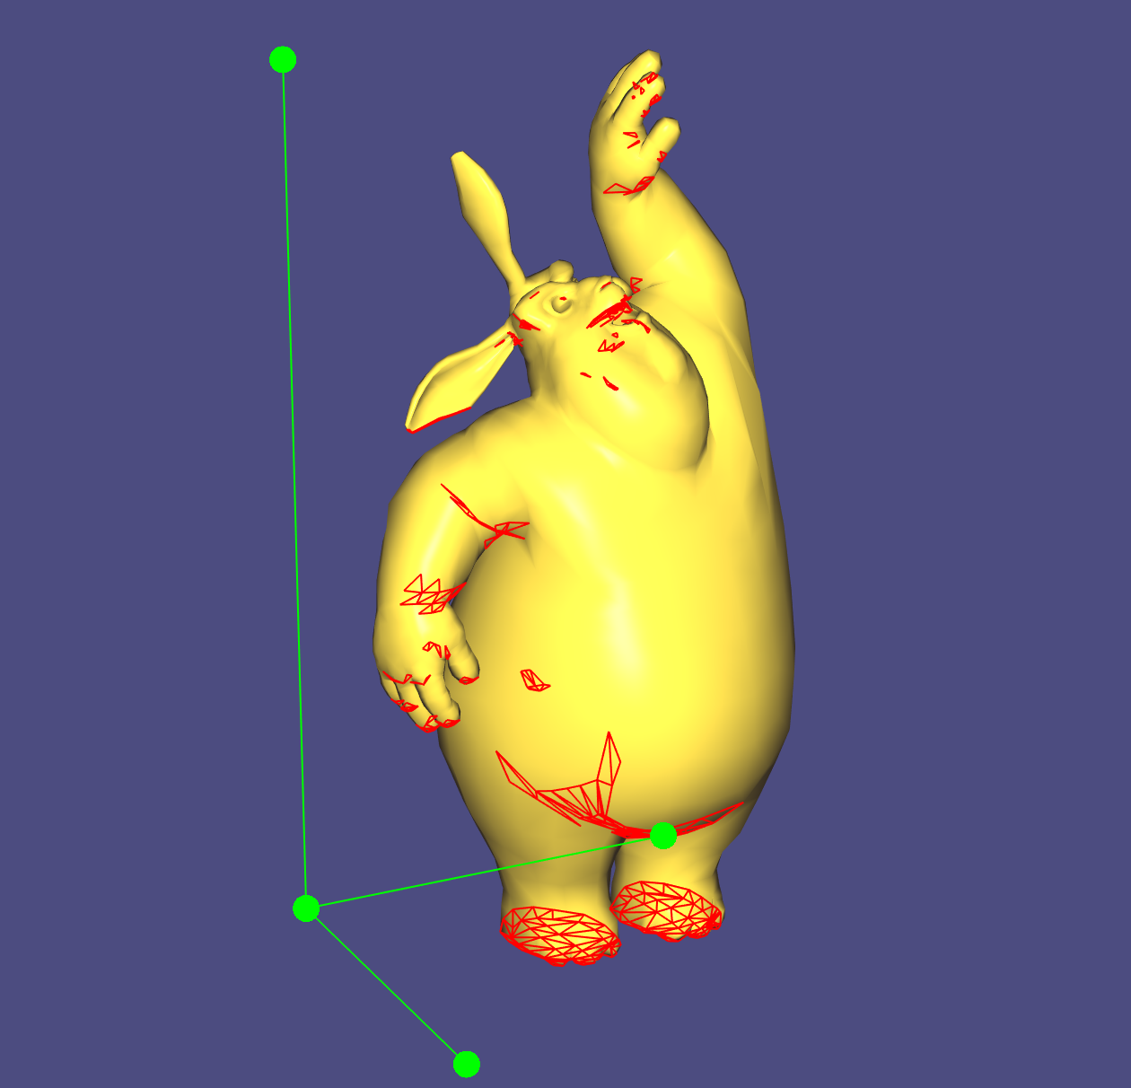

Slide 22
Questions?

